Slide 1
Multilevel Wavelet Packet Entropy
A New Strategy for Lung Sound Feature Extraction Based on Wavelet Entropy
Achmad Rizal, Risanuri Hidayat, Hanung Adi Nugroho
Department of Electrical Engineering and Information Technology, Universitas Gadjah
School of Electrical Engineering, Telkom University
rizal.s3te14@mail.ugm.ac.id

Slide 2
Introduction
Biological signal → structural richness (Costa, 2005)
Lung sound → respiration process → complex system → complex signal (Kitaoka, 1999)
Some signal complexity metrics: Hjorth descriptor, fractal dimension, correlation dimension, entropy

Slide 3
Introduction
Entropies: Shannon, Renyi, Tsallis, Spectral Entropy, Wavelet Entropy, Sample Entropy, Approximate entropy, Permutation entropy
Wavelet analysis + entropy = wavelet entropy / WE (Rosso, 2001)
Some WE extension : wavelet packet entropy (Safara, 2012)(Chen, 2015)

Slide 4
Introduction
Some WPE variations:
WPD + Perm entropy (Yan, 2009)
WPE (using Shannon, TE and RE) (Li&Zhou 2016)
Wavelet time entropy (2014)
Proposed method:
Multilevel wavelet packet entropy

Slide 5
Wavelet Entropy
E₁ = energy of D₁
E₂ = energy of D₂
E₃ = energy of D₃
E₄ = energy of A₃
E_{tot} = ∑E_{i} i = 1,…,4

Slide 6
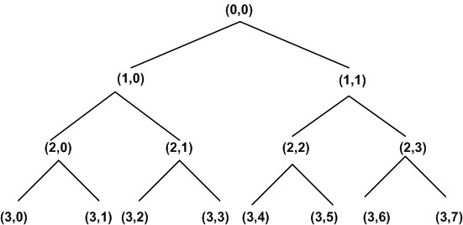
Wavelet Packet Entropy

Slide 7
Material & Method

Slide 8
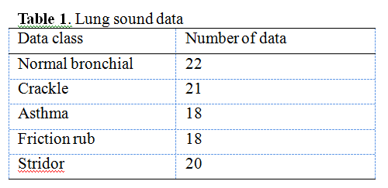
Material and Method
Format *.wav, fs= 8000Hz, 1 respiration cycle
http://jan.ucc.nau.edu/~daa/heartlung/breathsounds/contents.html.
http://www.rale.ca/Repository.htm.
http://www.med.ucla.edu/wilkes/lungintro.htm

Slide 9
Material and Method
MWPE
Mother wavelet: Haar, Db2, Db8, Bior1.3, Bior2.8
Decomposition level: 1-7
Classifier : Multilayer Perceptron
Validation : three-fold cross validation

Slide 10
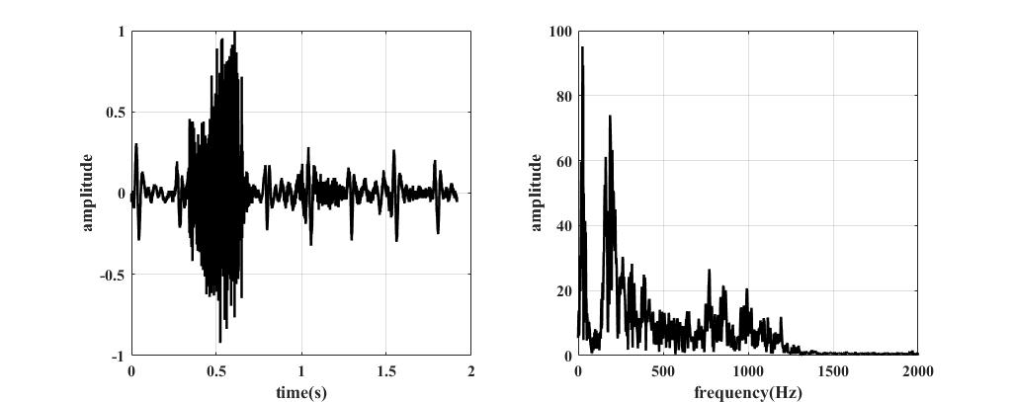
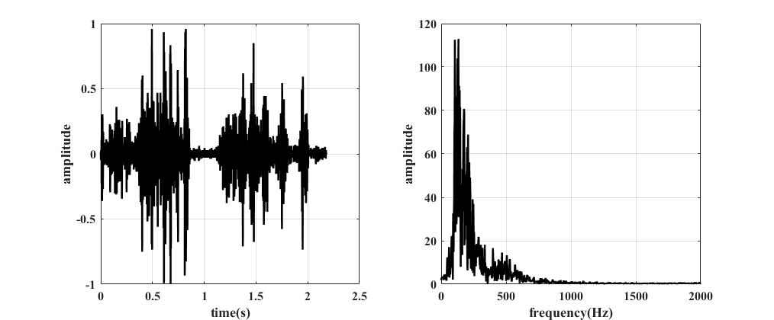
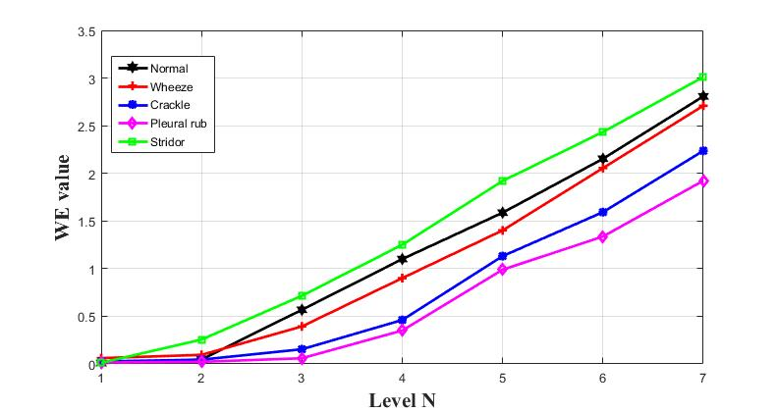
Results and Discussion
stridor
Pleural rub

Slide 11
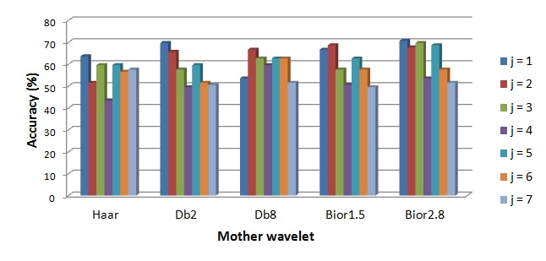
Results and Discussion
WPE (70.71% Bior2.8, N = 1)

Slide 12
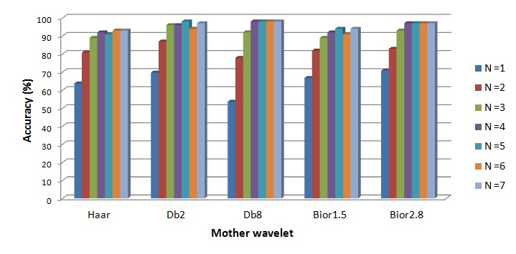
Results and Discussion
MWPE (97.98 %. DB8, N = 4 - 7)

Slide 13
Results and Discussion
MWPE → information of signal complexity in multiresolution domain
Higher level decomposition ≠ higher accuracy
For lung sound analysis → N = 4

Slide 14
Conclusion
wavelet entropy (WE) →DWT
wavelet packet entropy (WPD) → WPD
MWPE → WPD using N decomposition level
MWPE → higher accuracy than WPE
Next study → MWPE for other biological signal

Slide 15
Selected references
[A. Kandaswamy, C. S. Kumar, R. P. Ramanathan, S. Jayaraman, and N. Malmurugan, “Neural classification of lung sounds using wavelet coefficients.,” Comput. Biol. Med., vol. 34, no. 6, pp. 523–37, Sep. 2004.
[A. Hashemi, H. Arabalibiek, and K. Agin, “Classification of Wheeze Sounds Using Wavelets and Neural Networks,” in International Conference on Biomedical Engineering and Technology (2011), 2011, vol. 11, pp. 127–131.
A. Rizal, R. Hidayat, and H. A. Nugroho, “Multiresolution Modified Grey Level Difference for Respiratory Sound Classification,” Adv. Sci. Lett., vol 23, no 5, pp 3972–3974, May 2017.
O. A. Rosso, S. Blanco, J. Yordanova, V. Kolev, A. Figliola, M. Schu, and E. Bas, “Wavelet entropy : a new tool for analysis of short duration brain electrical signals,” J. Neurosci. Methods, vol. 105, pp. 65–75, 2001.
F. Safara, S. Doraisamy, A. Azman, A. Jantan, and S. Ranga, “Wavelet packet entropy for heart murmurs classification,” Adv. Bioinformatics, vol. 2012, 2012.

Slide 16
Multilevel Wavelet entropy
Single level WE

Slide 17
Multilevel Wavelet entropy
MWE

